Slide 1


CT to MR translation: Stroke Detection
胡晟 陈伟杰 2020.06.04

Slide 2
Motivation & Introduction
Methods & Datasets
Results & Evaluation
Conclusion
Future work

Slide 3
Motivation & Introduction
Stroke：脑卒中（俗称中风）
——CT诊断准确率低，难以判断（陈年脑阻塞与急性脑阻塞）
——急性发病
——MR准确，但扫描时间长、在许多医院分时段、需预约
考虑通过Image Translation，将CT图像中的隐藏信息和表面信息转换到MR图像上，辅助医生诊断。

Slide 4
Introduction
可行性分析：在成像结构上，CT和MR均为切片式，存在对应关系。
CT图像中某些病变不明显，可以通过转化突出和确定病变位置。医生的诊断准确率也和其资历有关，通过生成MR图可起到对资历较浅的医生的辅助效果。
我们的研究做了四种已有的Image Translation方法效果对比，并对效果最好的一种用了加权的pair loss和给定的mask结合进行后续工作。由于真实数据尚在和医院方商谈（目前拿到的数据来源于网络，没有label无法做分割），所以后续工作我们暂时只做了框架没有进行实验。

Slide 5
Methods
Five methods:
NICE-GAN: No-Independent-Component-for-Encoding GAN
UNIT: UNsupervised Image-to-image Translation
Pix2pix
CycleGAN
NICE-GAN(changed) for our own dataset with a classifier/detection network after the translation.

Slide 6
Datasets for contrast
367 paired CT&MR data, with T1-WI&T2-WI MR image
No label
Train: 300pairs, Test: 67pairs.

Slide 7
Dataset for Stroke
2830 unpaired data. 1607 CT image, 1223 T2-WI MR image
All from Stroke patient.
Train: 1547 CT image, 1183 MR image.
Test: 60 CT image, 40 MR image.

Slide 8
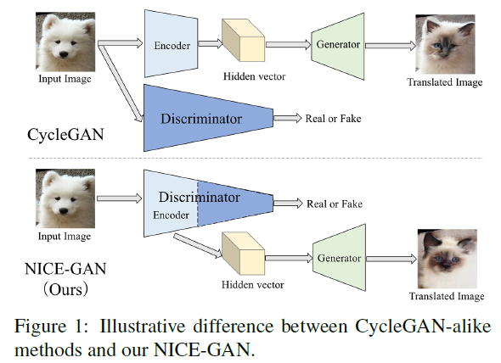
NICE-GAN: No-Independent-Component-for-Encoding GAN

Slide 9
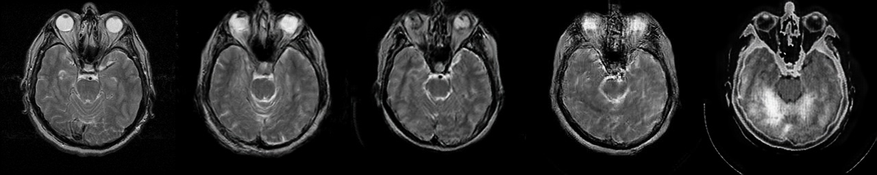
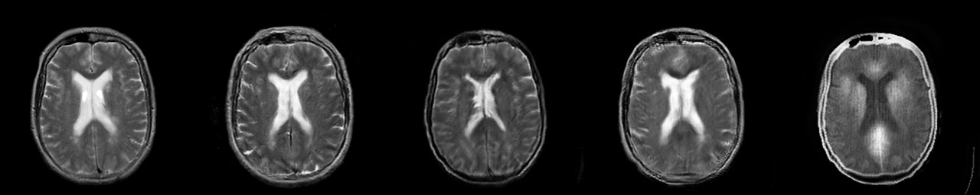
Compared of four methods-test data
MR origin NICE-GAN PIX2PIX UNIT CycleGAN

Slide 10
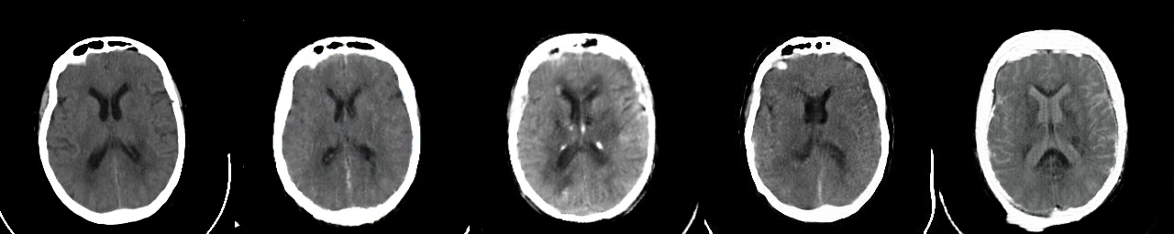
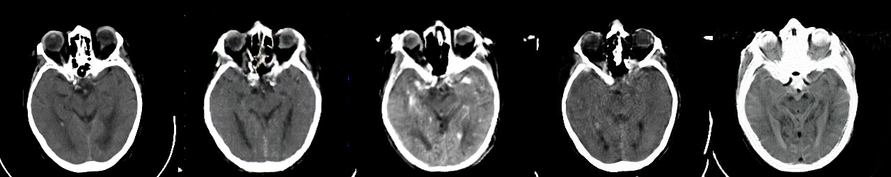
Compared of four methods-test data
MR origin NICE-GAN PIX2PIX UNIT CycleGAN

Slide 11
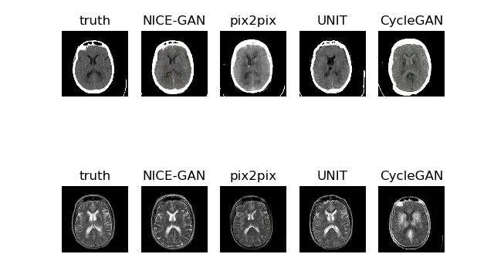
Compared of four methods-test data

Slide 12
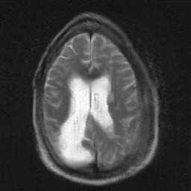
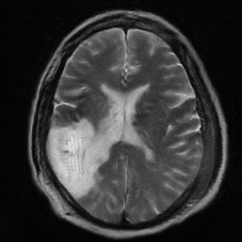
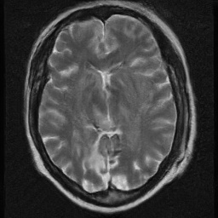
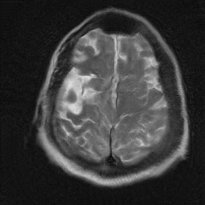
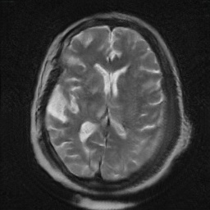
Results- Stroke unpaired dataset

Slide 13
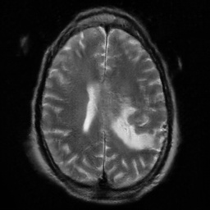
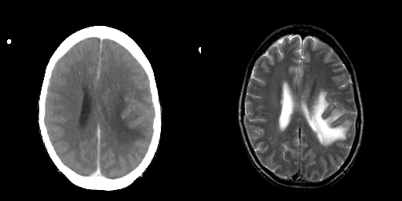
Results-paired dataset with Stroke model
Fake-MR
Real-CT Real-MR

Slide 14
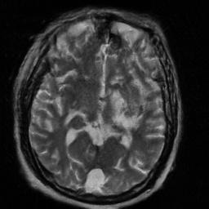
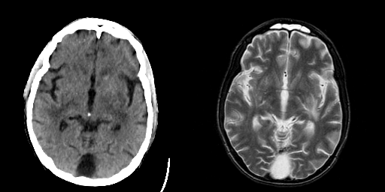
Results-paired dataset with Stroke model
Fake-MR
Real-CT Real-MR

Slide 15
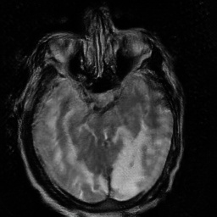
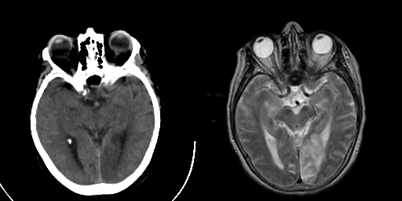
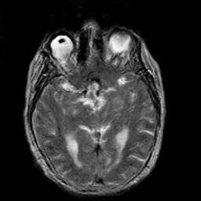
Results-paired dataset(test) with Stroke model
Stroke Model
Fake-MR
normal Model
Real-CT Real-MR

Slide 16
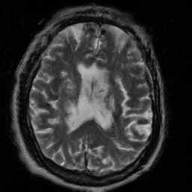
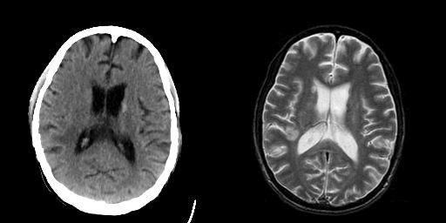
Results-paired dataset with Stroke model
Fake-MR
Real-CT Real-MR

Slide 17
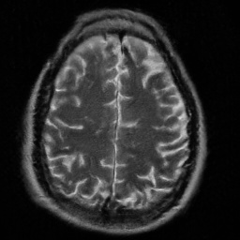
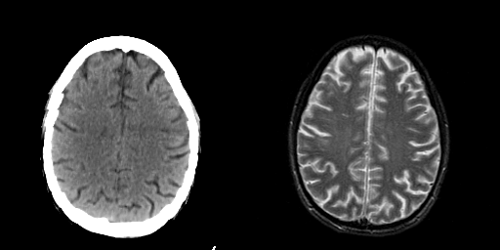
Results-paired dataset with Stroke model
Fake-MR
Real-CT Real-MR

Slide 18
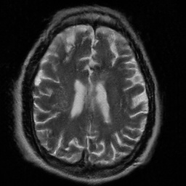
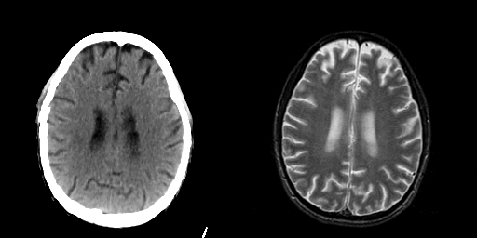
Results-paired dataset with Stroke model
Fake-MR
Real-CT Real-MR

Slide 19
Results: Stroke model on paired dataset
Due to unknown label and unknown type(T1 or T2 …), effect of translation are various with different image.
Reinforce some unusual region in CT image.

Slide 20
Evaluation
CT data | FID | KID*100 | MSE | PSNR | SSIM
NICE-GAN | 160.4225 | 6.6901 | 33.5919 | 32.2028 | 0.6546
Pix2pix | 175.6467 | 9.2584 | 33.4935 | 32.2564 | 0.6889
UNIT | 175.4811 | 8.7179 | 38.9762 | 32.8983 | 0.6769
CycleGAN | 187.6999 | 10.9101 | 39.3379 | 32.8989 | 0.5673
MR data | FID | KID*100 | MSE | PSNR | SSIM
NICE-GAN | 74.0494 | 1.8381 | 44.0960 | 31.5949 | 0.5898
pix2pix | 89.5002 | 4.5898 | 45.6156 | 31.5800 | 0.6242
UNIT | 101.4364 | 5.7145 | 45.4120 | 31.7387 | 0.6286
CycleGAN | 174.7381 | 14.5448 | 45.9759 | 31.5226 | 0.4861
Unpaired Stroke data(only NICE-GAN):
CT: FID:174.7253 KID:7.2776 MR:FID:81.9519 KID:1.9259

Slide 21
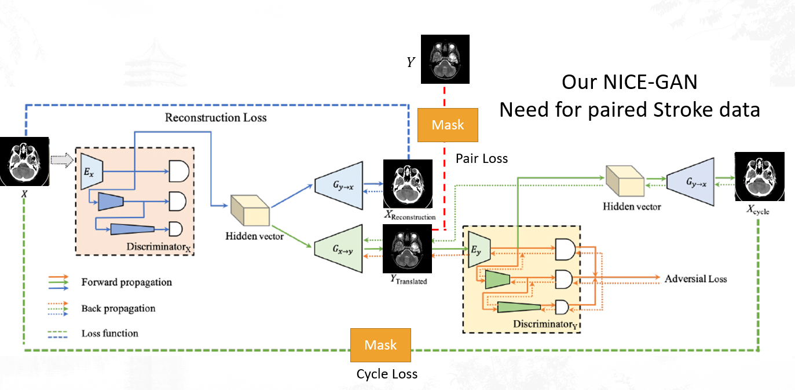

Slide 22
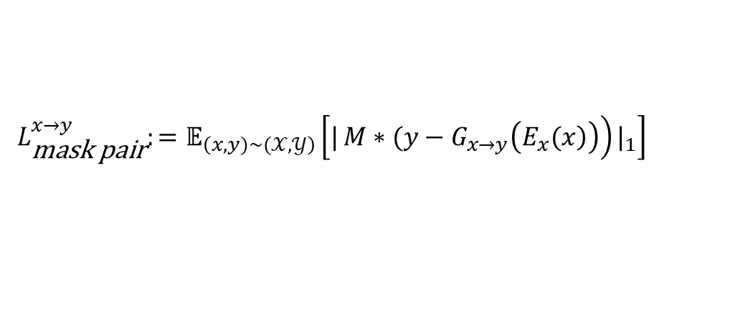
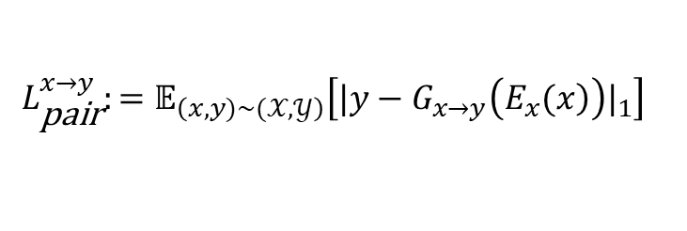
Pair Loss(One direction)
$$L_{\text{pair}}^{x→y}:=𝔼_{\left(x,y)\sim (𝒳,𝒴\right)}\left[{|y−G_{x→y}\left(\left.E_{x}(x\right)\right)|}_{1}\right]$$
Mask Pair Loss(One direction)
$$L_{\text{mask} \text{pair}}^{x→y}:=𝔼_{\left(x,y)\sim (𝒳,𝒴\right)}\left[{|\left.M∗(y−G_{x→y}\left(\left.E_{x}(x\right)\right)\right)|}_{1}\right]$$

Slide 23
Conclusion
CT to MR image translation is feasible.
Among four methods, NICE-GAN performs the best.
We managed to translate CT images with clear nidus(病灶) into MR images with the same nidus as well as those without nidus translate into MR images without nidus.
In Stroke dataset, we have the same result.
Now we focus on the CT image with vague nidus but related MR image has nidus. We are waiting for the hospital to provide the dataset.

Slide 24
Future work
Get real data from the hospital
Tell the doctor to help us label the data with ROIs(detection).
Using occurrence of stroke in ROIs in MR/CT image as label(mask).
Train our own NICE-GAN model with specific data
Using a classification/detection model to recognize stroke region.

Slide 25
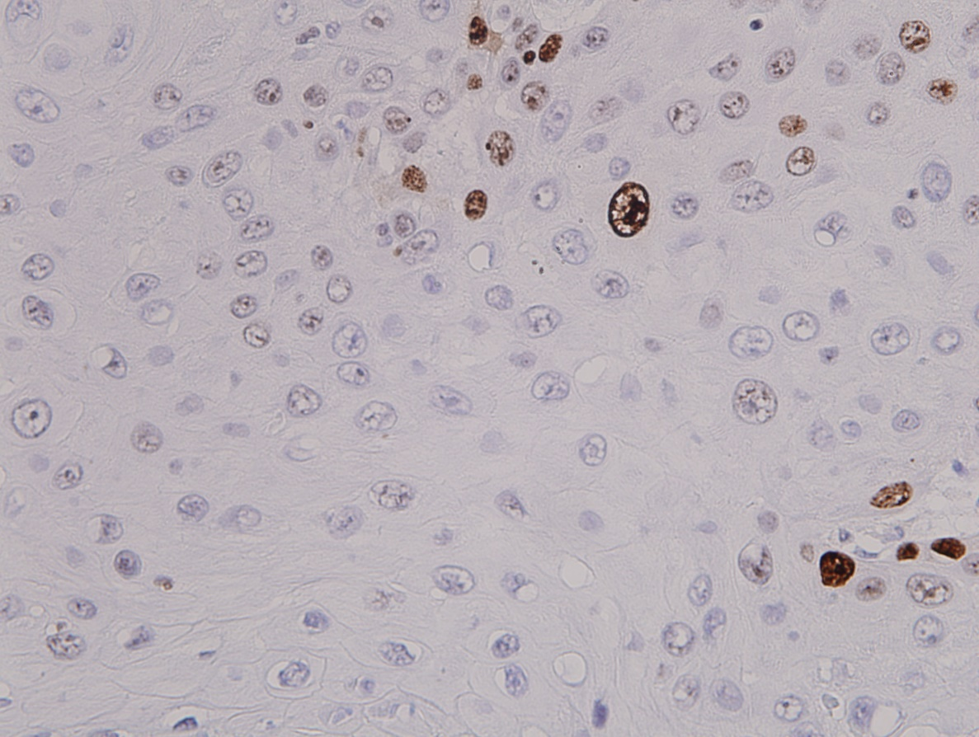

Other work-Using pix2pix to recognize nucleus of cells.

Slide 26
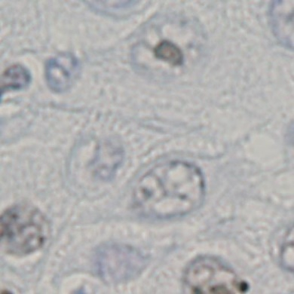
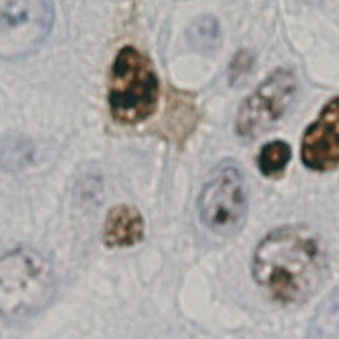
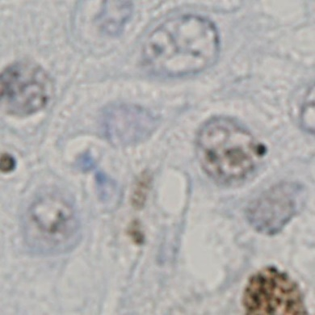
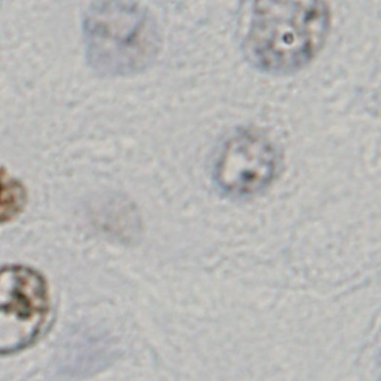
Other work-Using pix2pix to recognize nucleus of cells.

Slide 27
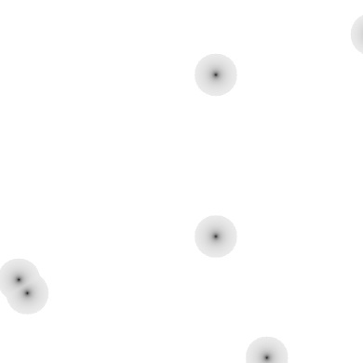


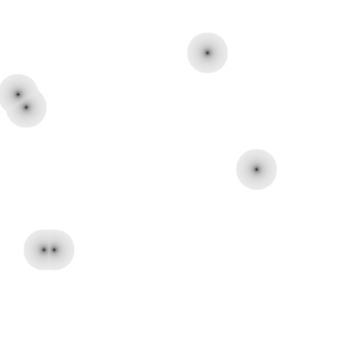
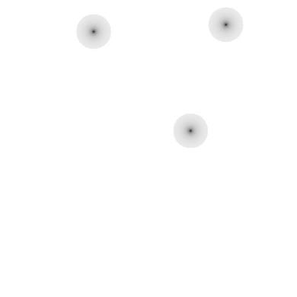
Other work-Using pix2pix to recognize nucleus of cells.

Slide 28
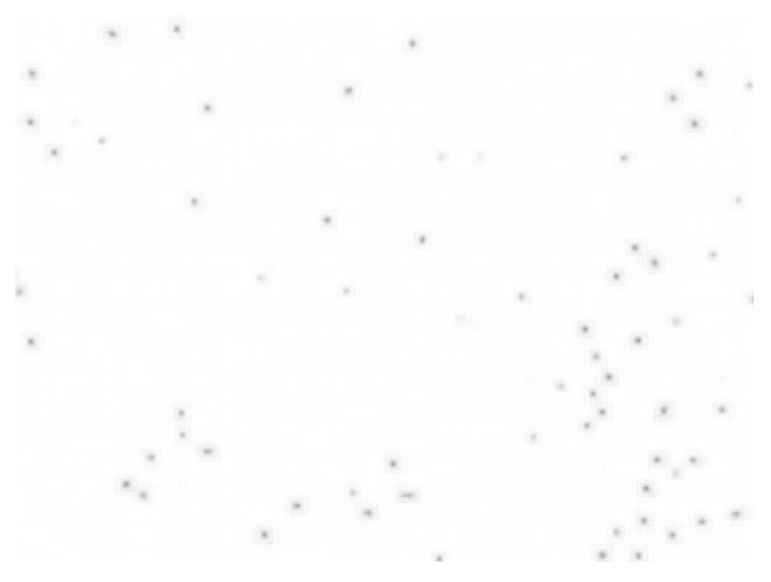
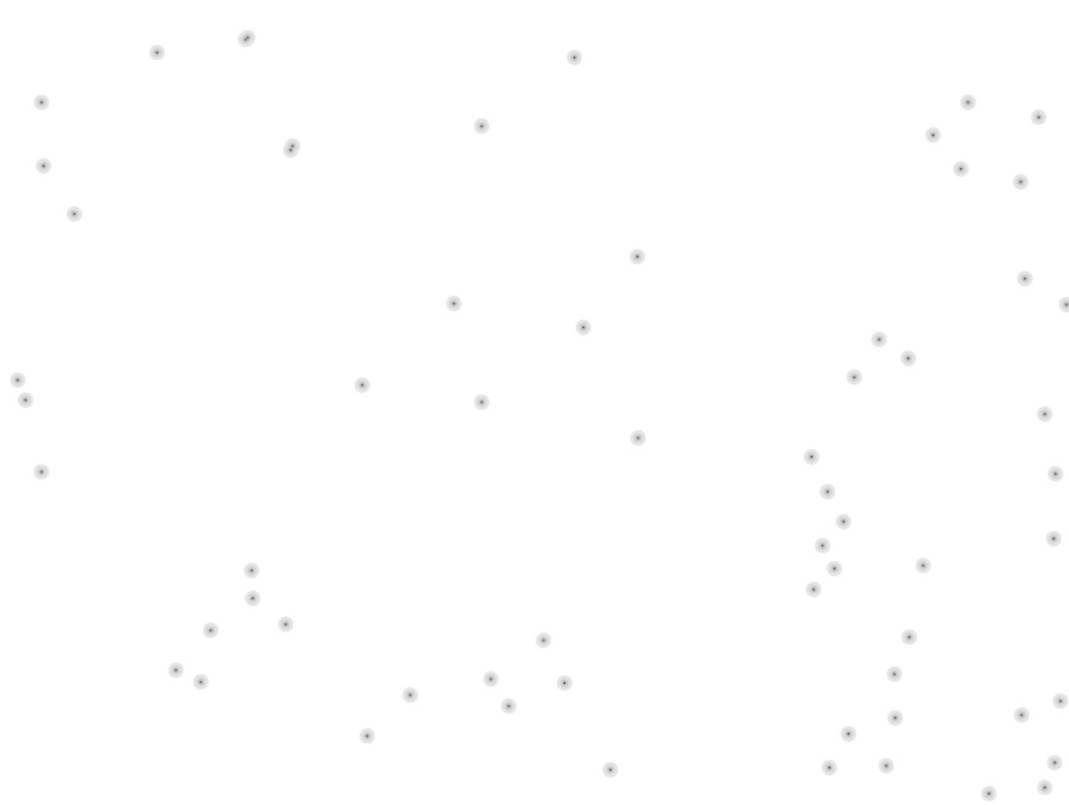
Other work-Using pix2pix to recognize nucleus of cells.
Predict Truth
Using pix2pix TN = 53 FP = 7 FN = 2

Slide 29

Other work-Using pix2pix to recognize nucleus of cells.
Predict Truth
Using VGGNET

Slide 30
THANKS!

